Slide 1
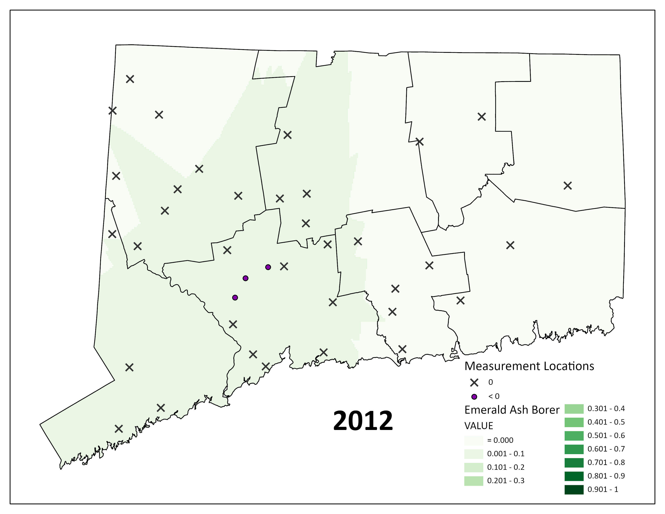

Slide 2
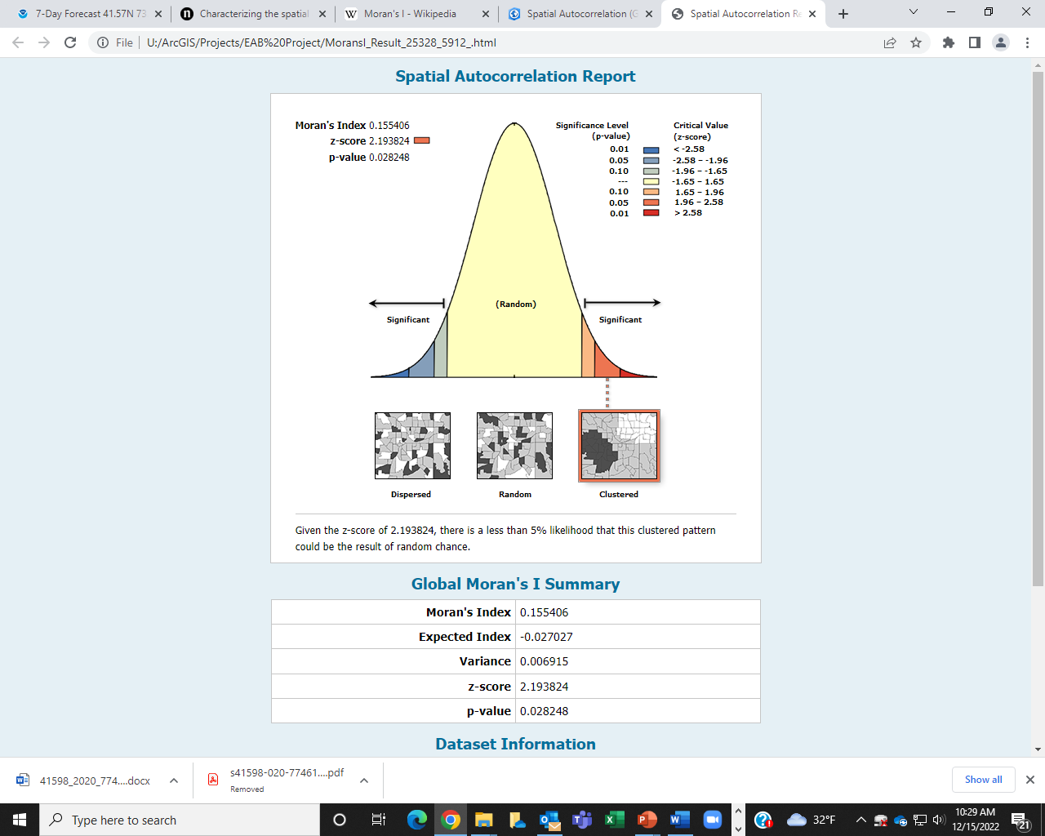

Slide 3
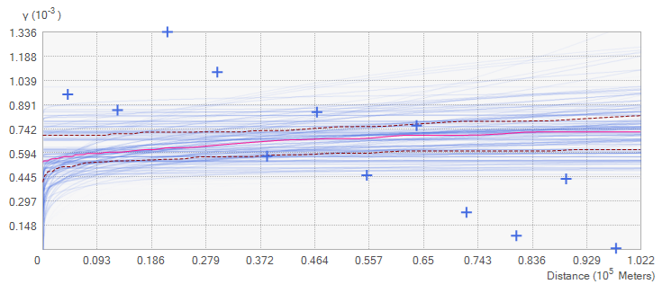
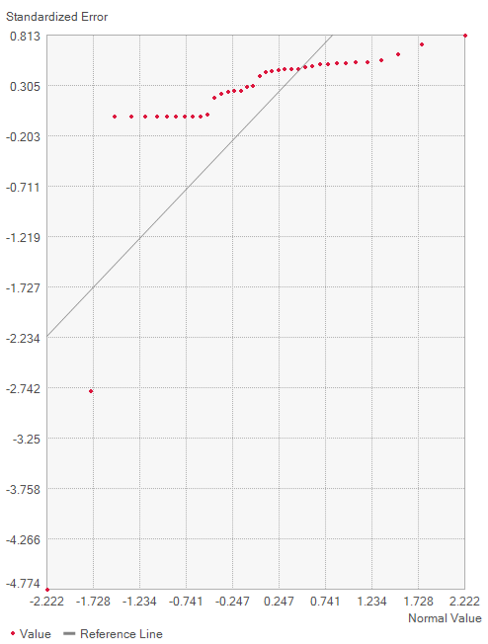
2012
Normal QQ plot
Count | 38 | # SAMPLES
Average CRPS | 0.011842 | Continuous Ranke Probability Score. Should be small as possible
Inside 90 Percent Interval | 94.73684 | should be close to 90
Inside 95 Percent Interval | 94.73684 | should be close to 95
Mean | 0.003079 | mean error, the averaged difference between the measured and predicted values
Root-Mean-Square | 0.025506 | the smaller the better
Mean Standardized | 0.11477 | should be close to zero
Root-Mean-Square Standardized | 0.980368 | should be close to one
Average Standard Error | 0.026372 | Should be close to Root-Mean Square

Slide 4
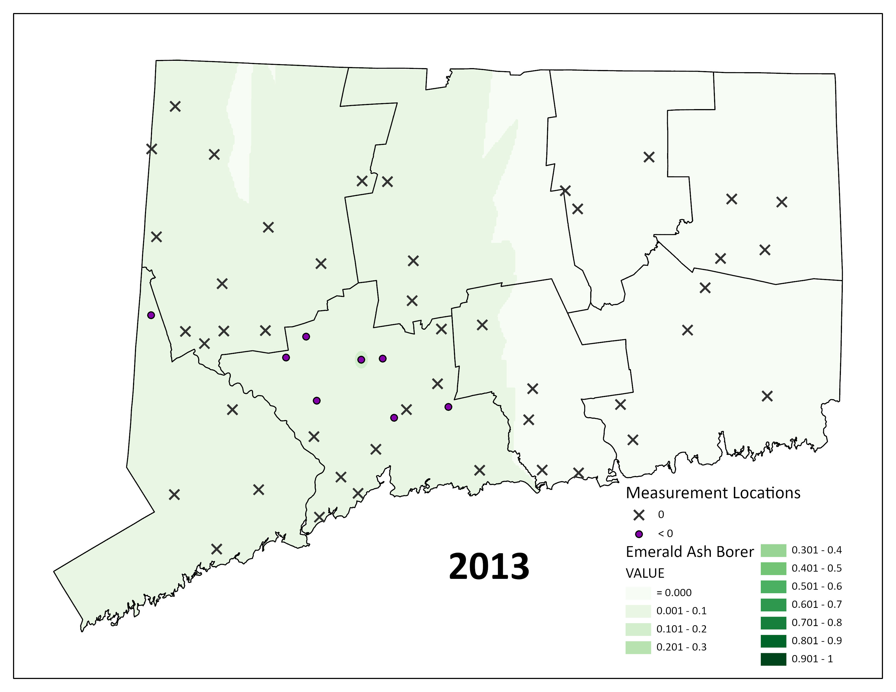

Slide 5
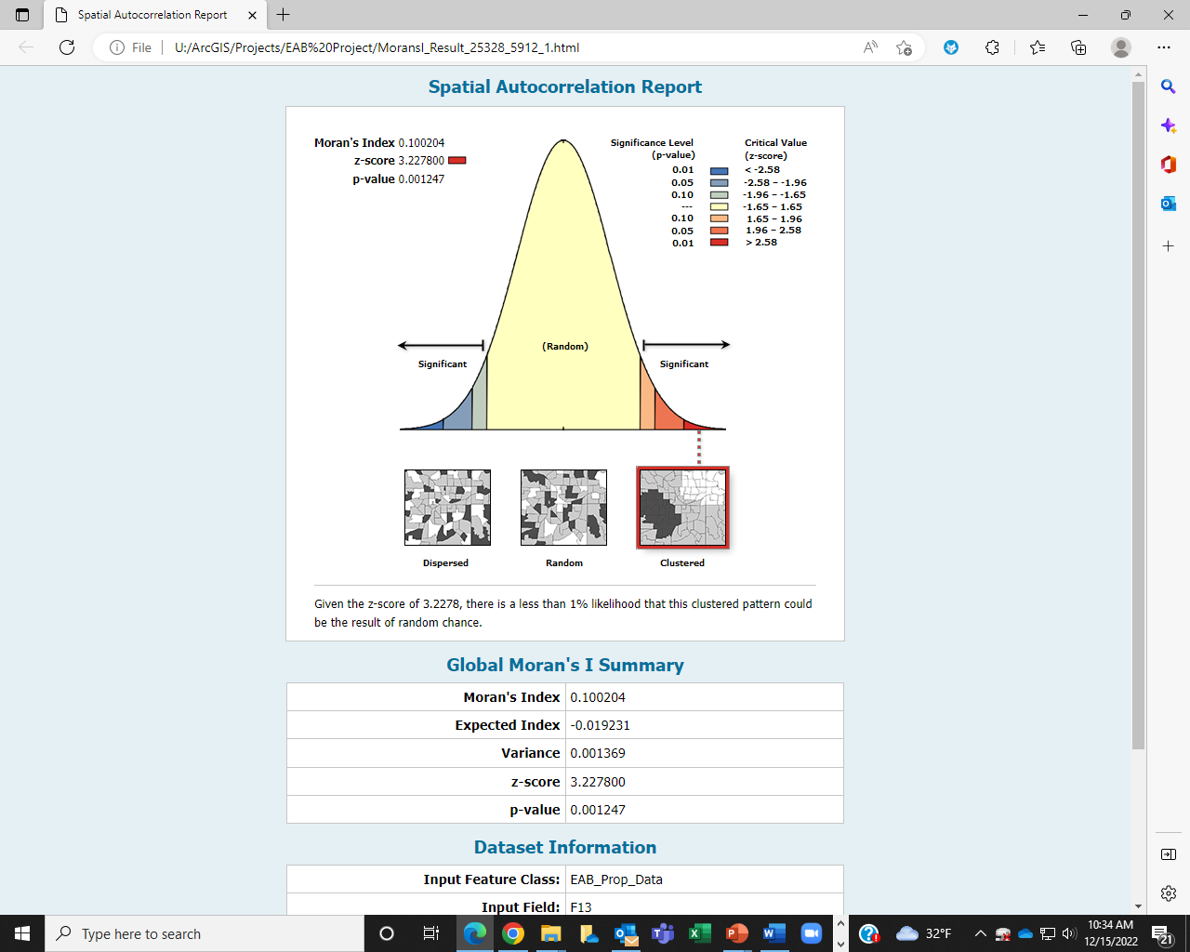

Slide 6
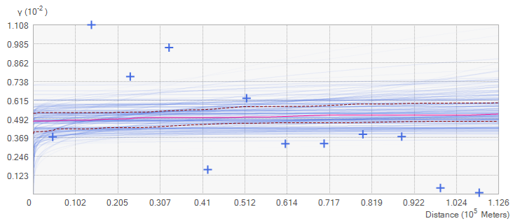
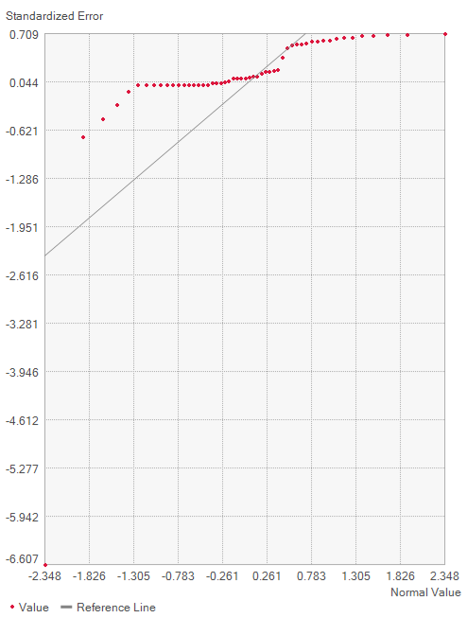
2013
Count | 53
Average CRPS | 0.029207
Inside 90 Percent Interval | 98.11321
Inside 95 Percent Interval | 98.11321
Mean | 0.006615
Root-Mean-Square | 0.071365
Mean Standardized | 0.090324
Root-Mean-Square Standardized | 0.986514
Average Standard Error | 0.073224

Slide 7
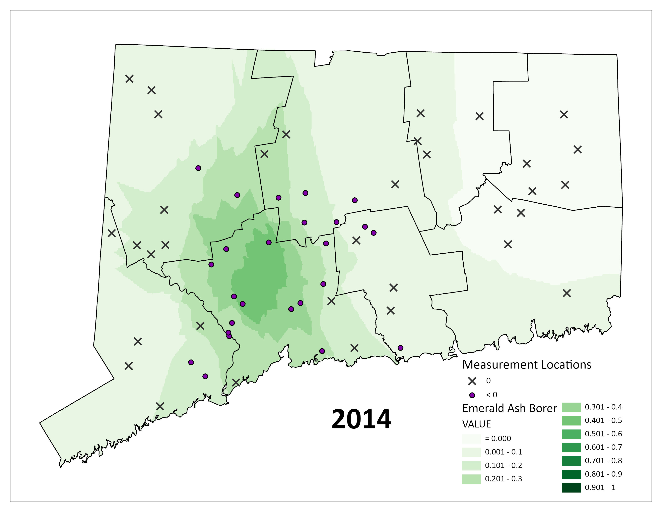

Slide 8
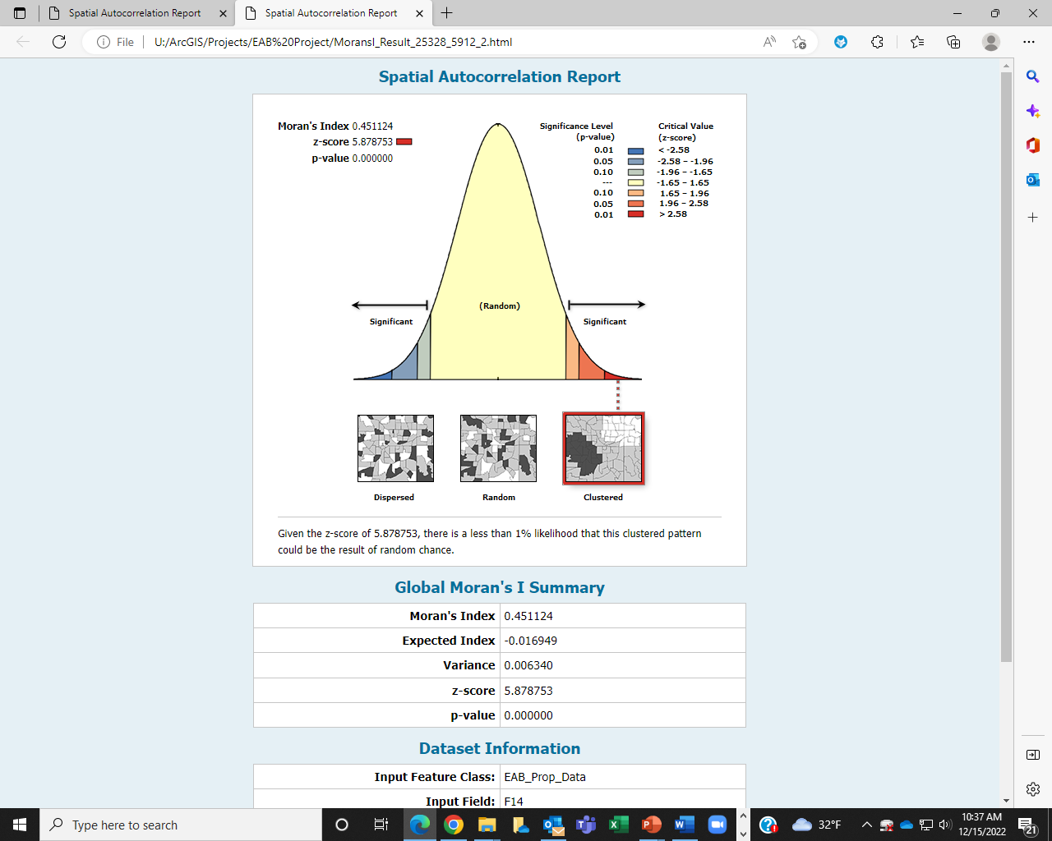

Slide 9
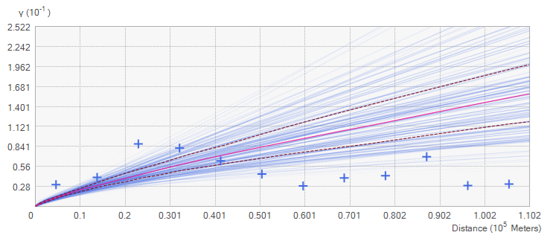
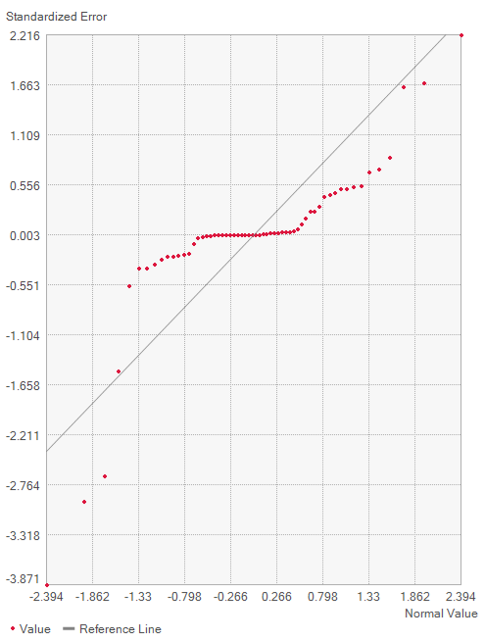
2014
Count | 60
Average CRPS | 0.062784
Inside 90 Percent Interval | 91.66667
Inside 95 Percent Interval | 93.33333
Mean | -0.00349
Root-Mean-Square | 0.120017
Mean Standardized | -0.02315
Root-Mean-Square Standardized | 0.897049
Average Standard Error | 0.149662

Slide 10
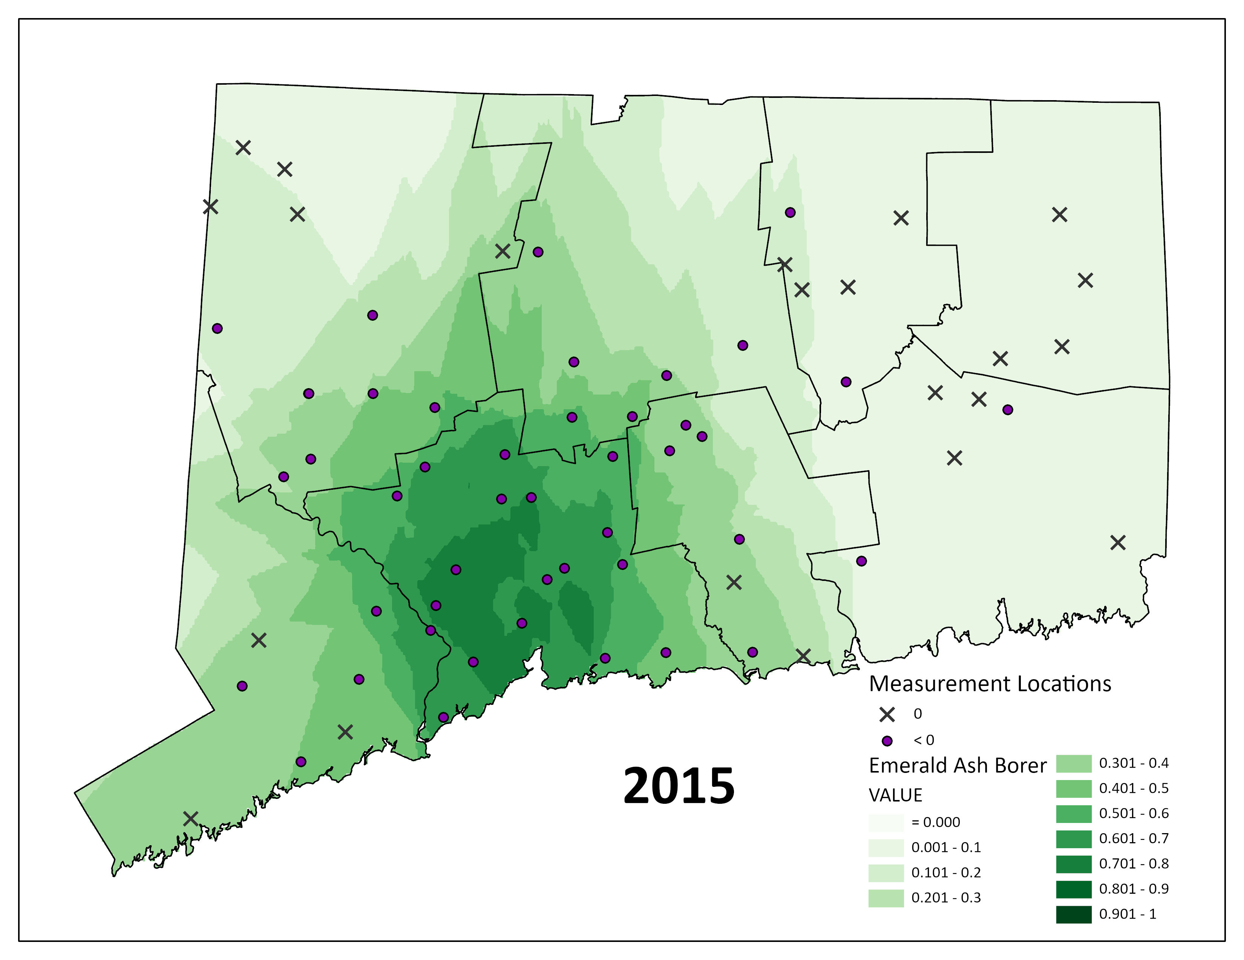

Slide 11
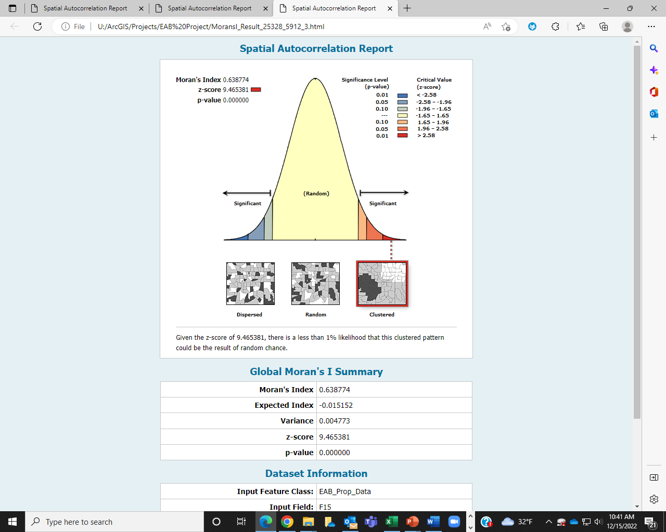

Slide 12
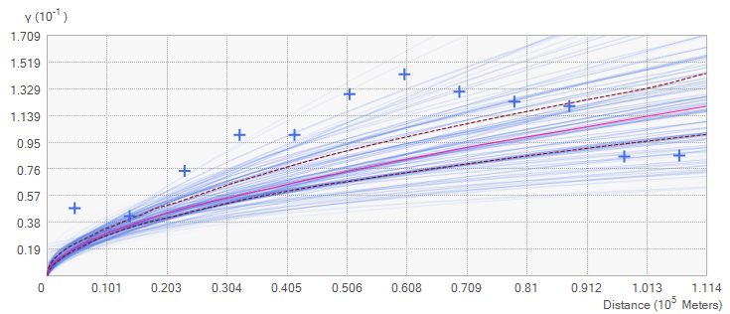
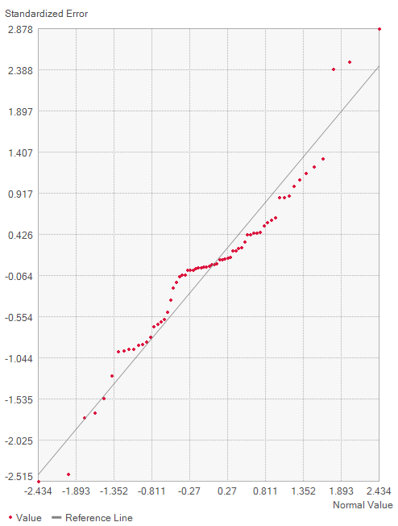
2015
Count | 67
Average CRPS | 0.092723
Inside 90 Percent Interval | 89.55224
Inside 95 Percent Interval | 92.53731
Mean | 0.004463
Root-Mean-Square | 0.167545
Mean Standardized | 0.01353
Root-Mean-Square Standardized | 0.968091
Average Standard Error | 0.182537

Slide 13
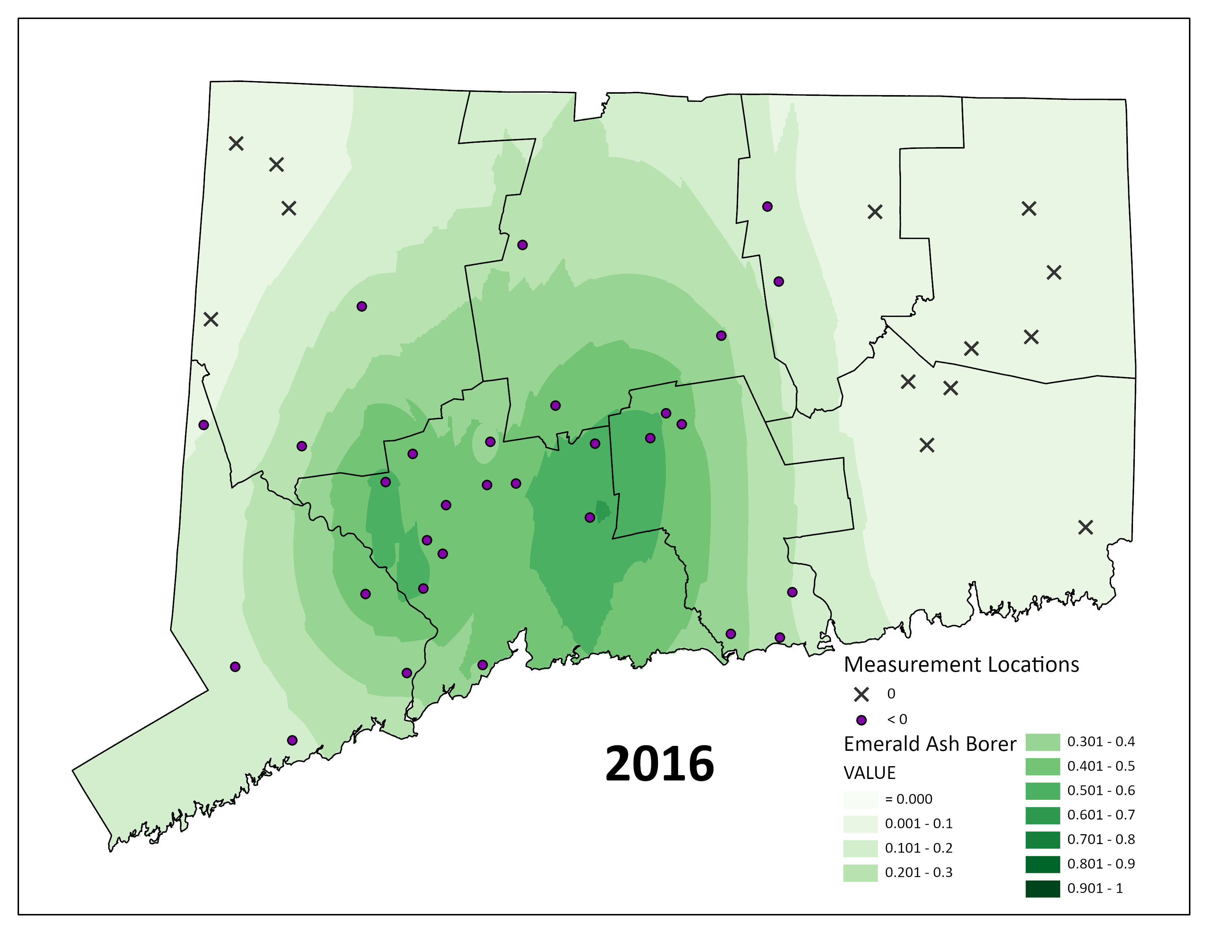

Slide 14
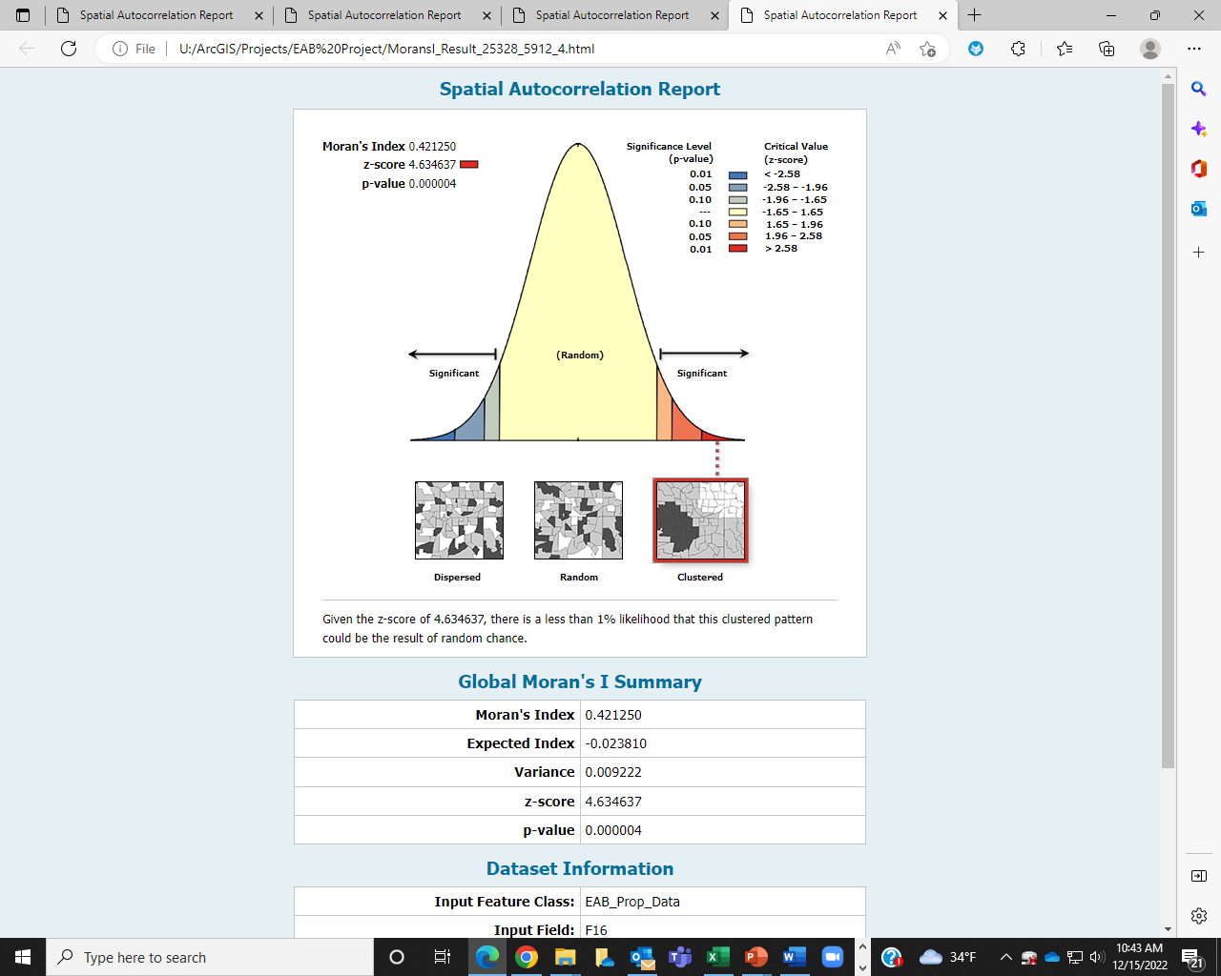

Slide 15
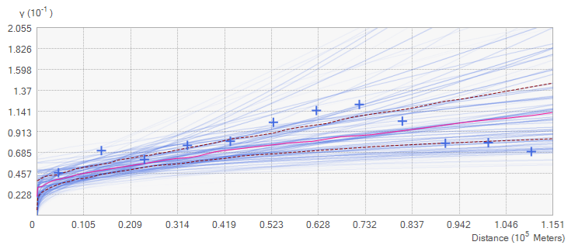
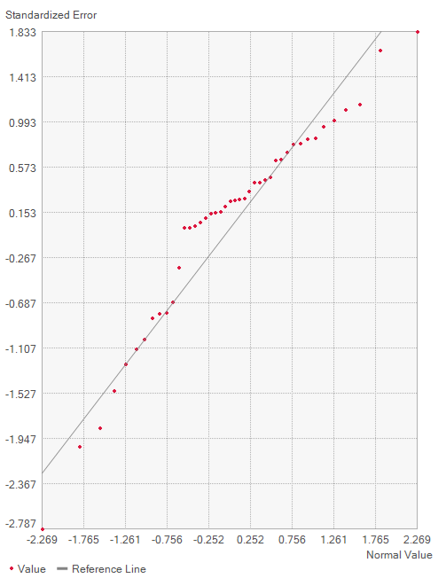
2016
Count | 43
Average CRPS | 0.124331
Inside 90 Percent Interval | 88.37209
Inside 95 Percent Interval | 95.34884
Mean | 0.014745
Root-Mean-Square | 0.219184
Mean Standardized | 0.049474
Root-Mean-Square Standardized | 0.963086
Average Standard Error | 0.23601

Slide 16
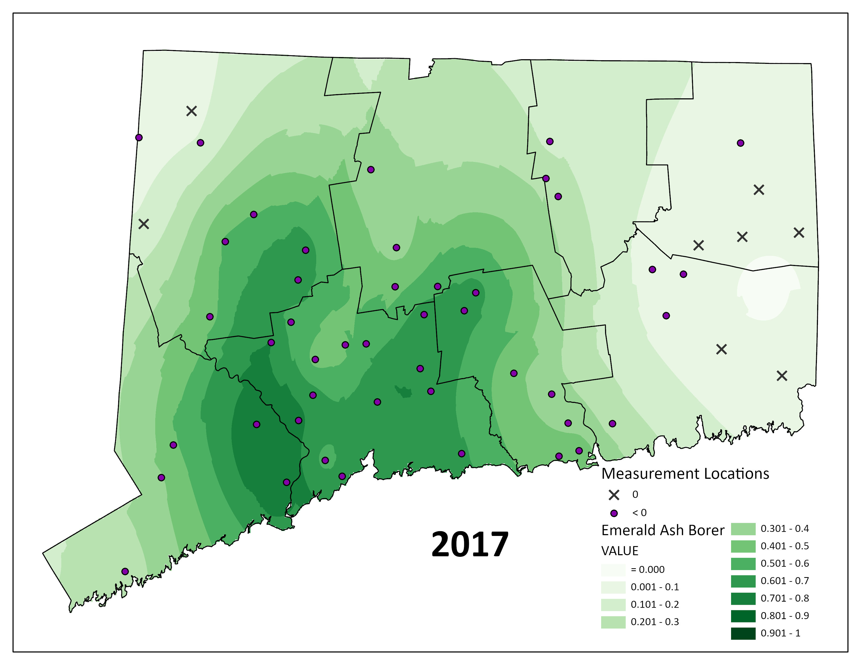

Slide 17


Slide 18
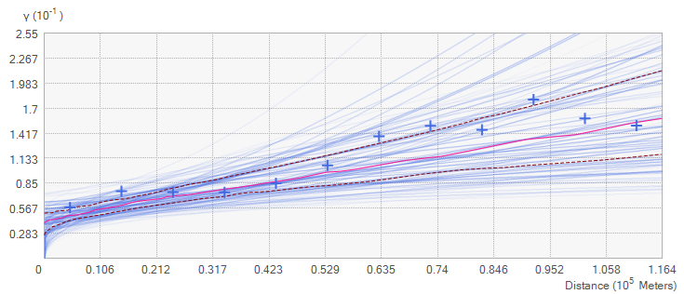
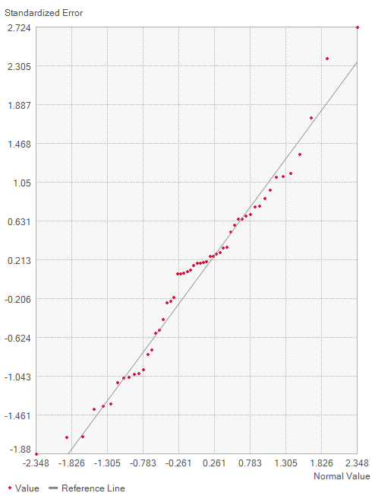
2017
Count | 53
Average CRPS | 0.140422
Inside 90 Percent Interval | 88.67925
Inside 95 Percent Interval | 96.22642
Mean | 0.015735
Root-Mean-Square | 0.24788
Mean Standardized | 0.047991
Root-Mean-Square Standardized | 0.985122
Average Standard Error | 0.256197

Slide 19
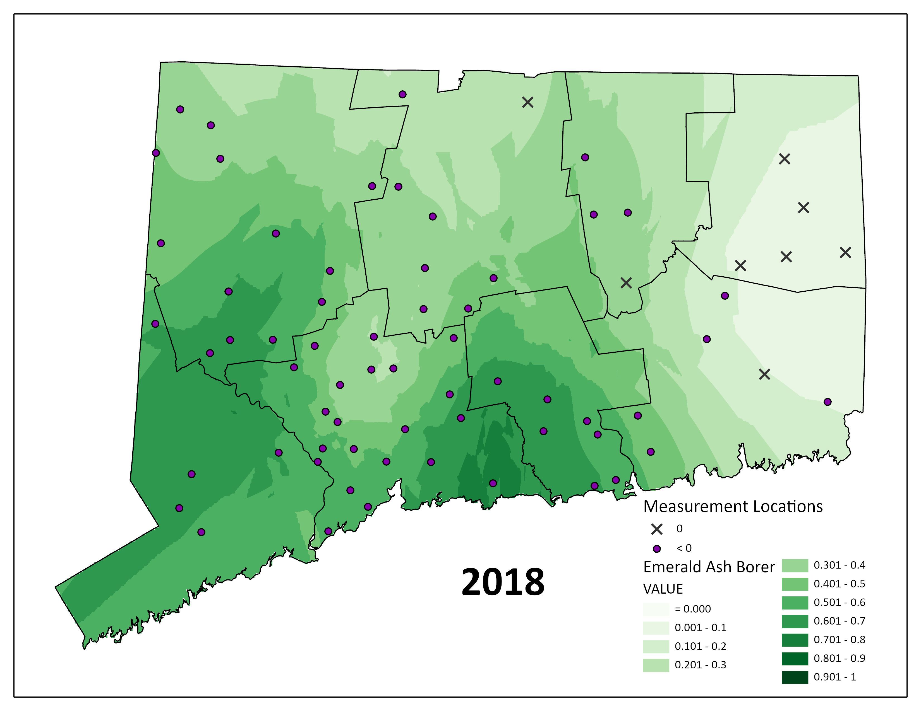

Slide 20


Slide 21
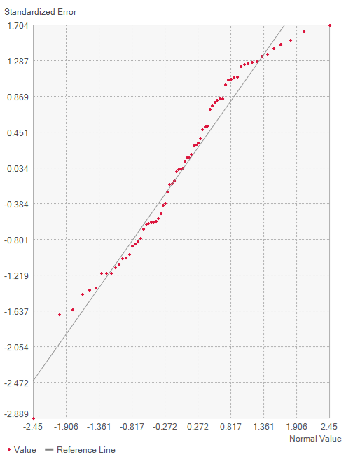
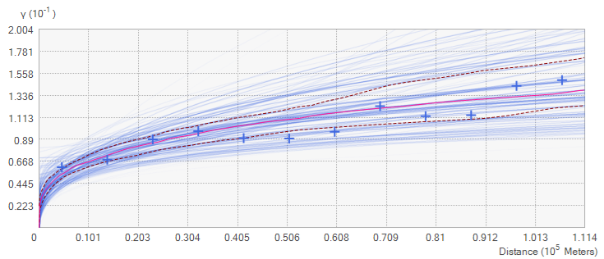
Count | 70
Average CRPS | 0.157441
Inside 90 Percent Interval | 95.71429
Inside 95 Percent Interval | 98.57143
Mean | 0.008352
Root-Mean-Square | 0.275509
Mean Standardized | 0.023972
Root-Mean-Square Standardized | 0.999567
Average Standard Error | 0.273613
2018

Slide 22
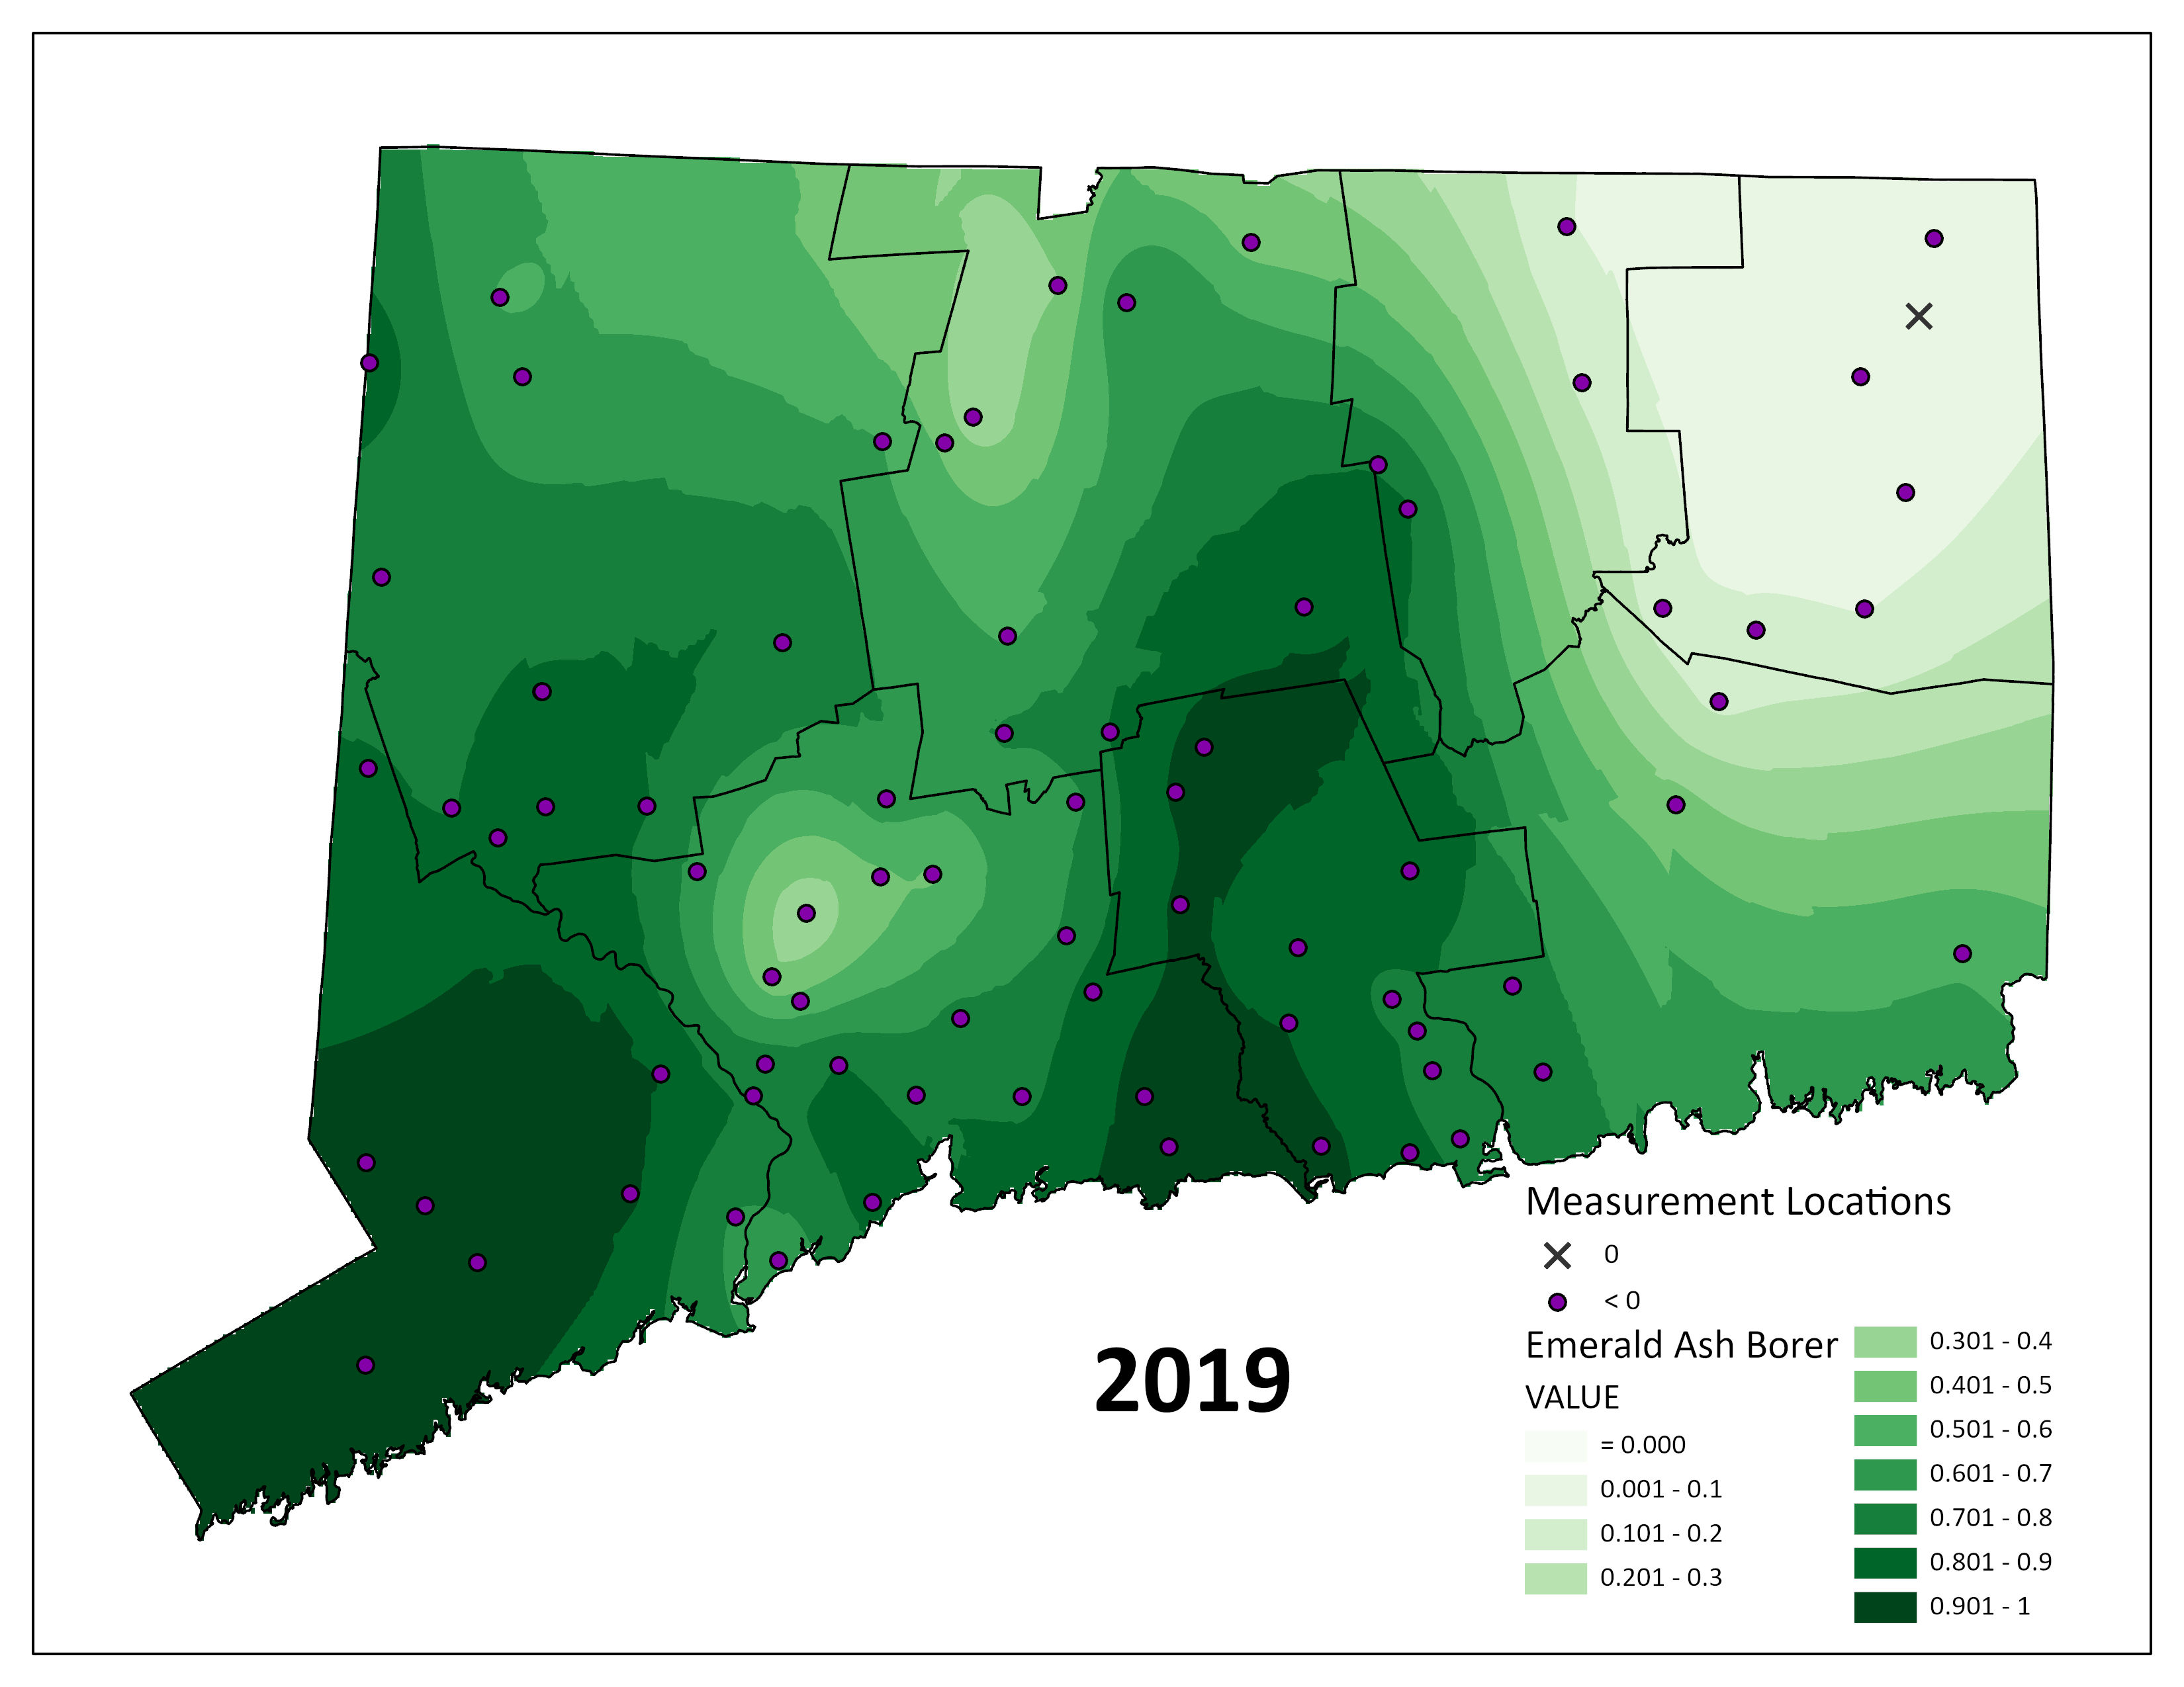

Slide 23


Slide 24
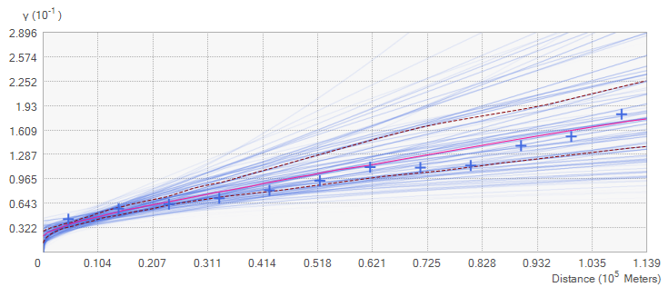
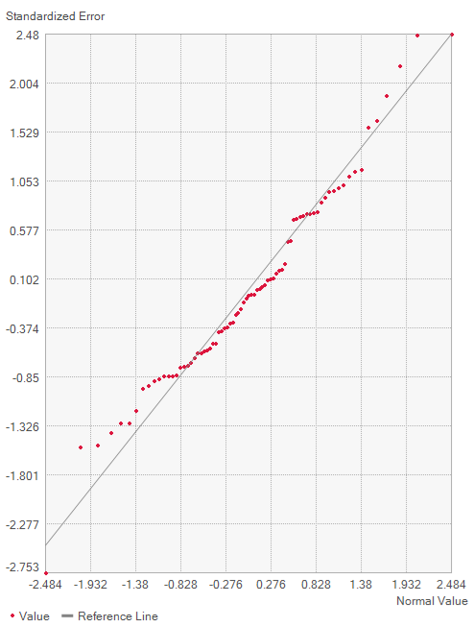
2019
Count | 77
Average CRPS | 0.11934
Inside 90 Percent Interval | 93.50649
Inside 95 Percent Interval | 94.80519
Mean | -0.00018
Root-Mean-Square | 0.212609
Mean Standardized | 0.004329
Root-Mean-Square Standardized | 0.957663
Average Standard Error | 0.225082

Slide 25
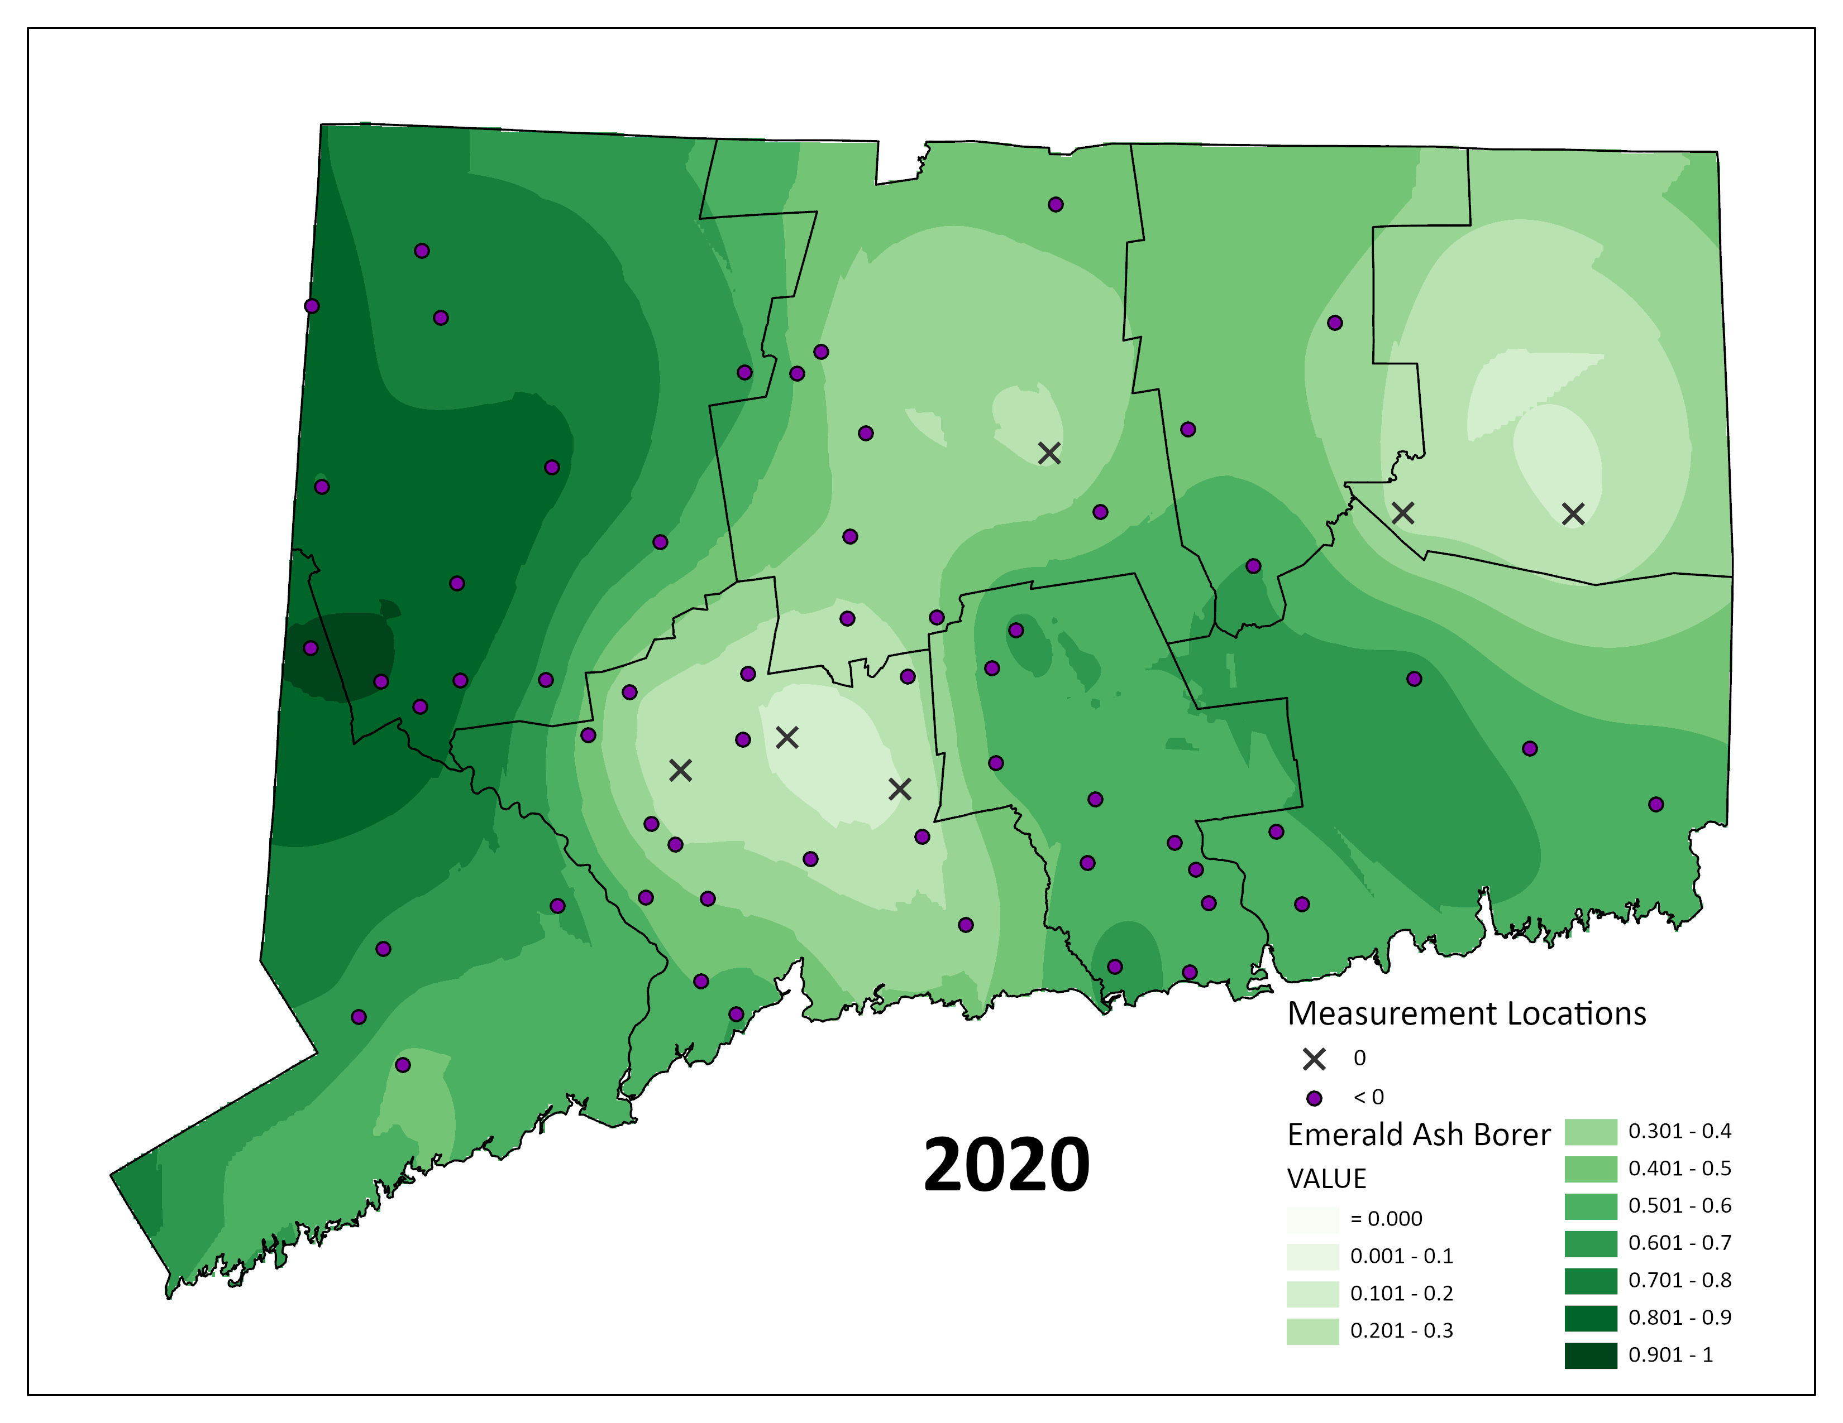

Slide 26
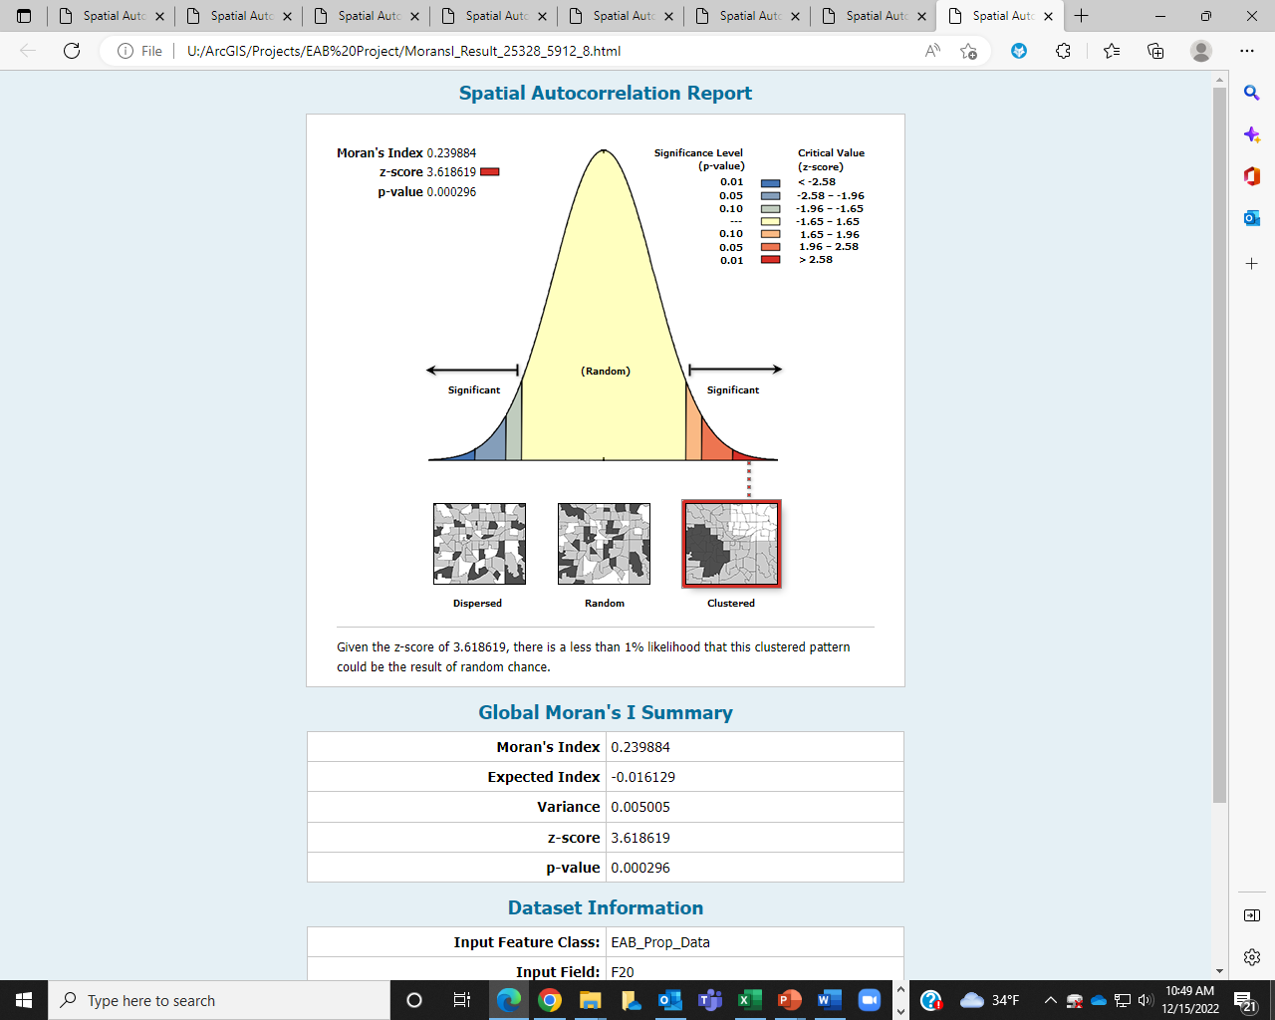

Slide 27
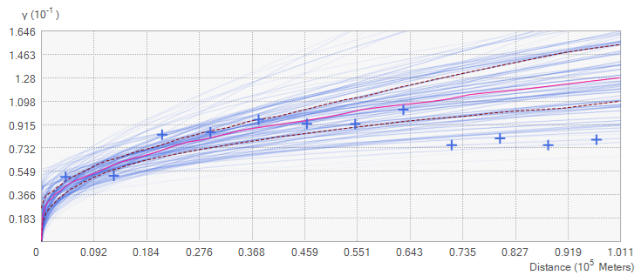
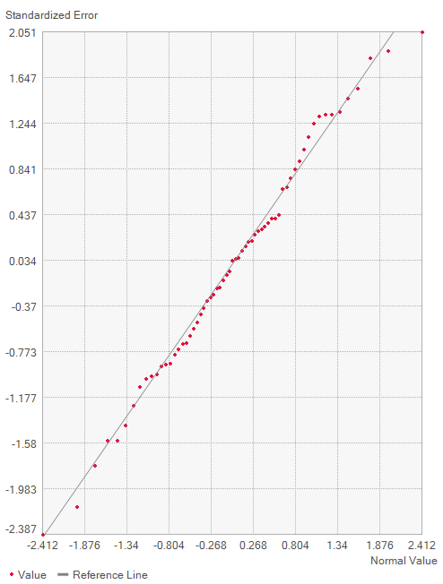
2020
Count | 63
Average CRPS | 0.14383
Inside 90 Percent Interval | 90.47619
Inside 95 Percent Interval | 95.2381
Mean | -0.00393
Root-Mean-Square | 0.25388
Mean Standardized | -0.01325
Root-Mean-Square Standardized | 0.999082
Average Standard Error | 0.252313

Slide 28
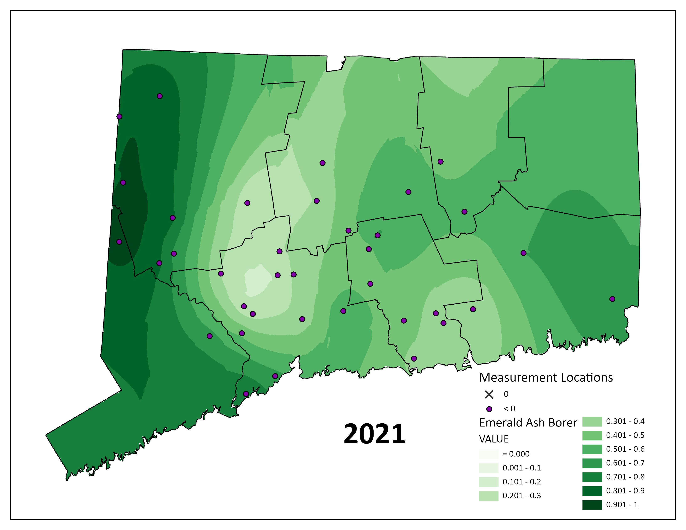
Volunteers | 19
Sites | 67
Family | 3
Genus | 16
Species | 51
# EAB | 1139
Total | 2110

Slide 29
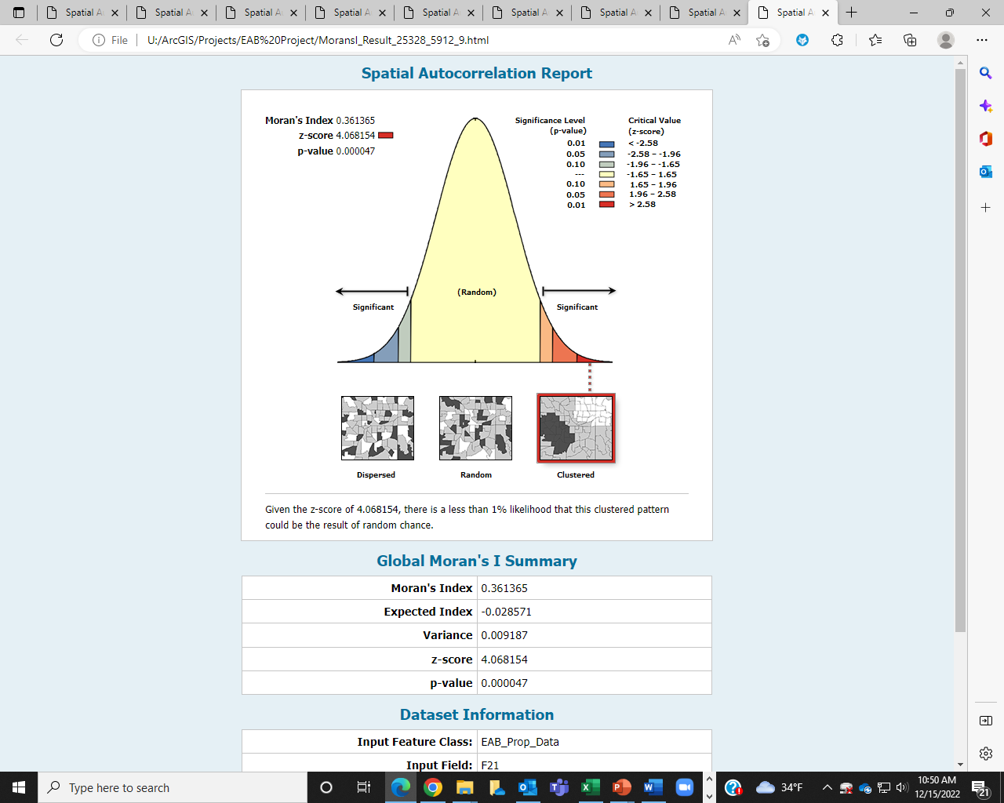

Slide 30
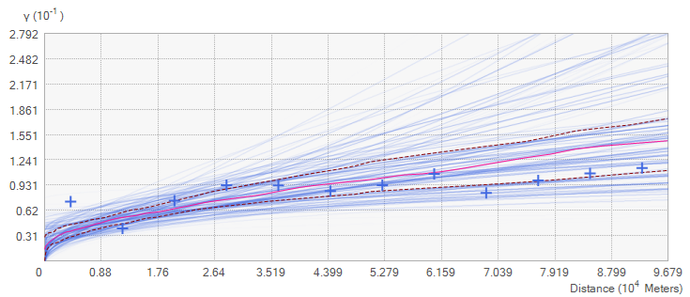
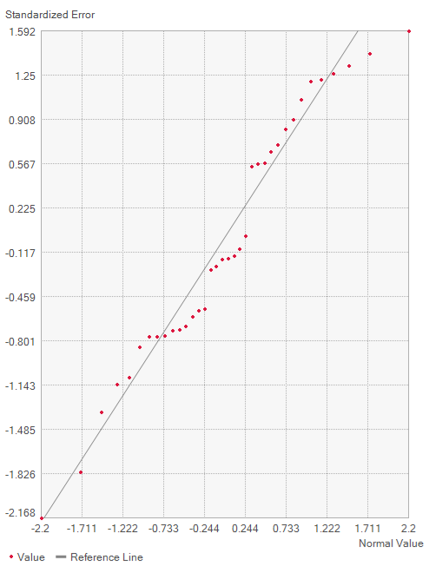
2021
Count | 36
Average CRPS | 0.133792
Inside 90 Percent Interval | 94.44444
Inside 95 Percent Interval | 97.22222
Mean | -0.01598
Root-Mean-Square | 0.229482
Mean Standardized | -0.04676
Root-Mean-Square Standardized | 0.954591
Average Standard Error | 0.249121

Slide 31
Summary Stats
Autocorrelation Stats
Year | Moran’s Index | Z value | p-value
2012 | 0.155406 | 2.193824 | 0.028248
2013 | 0.100204 | 3.2278 | 0.001247
2014 | 0.451124 | 5.878753 | 0
2015 | 0.638774 | 9.465381 | 0
2016 | 0.42125 | 4.634637 | 0.000004
2017 | 0.527994 | 5.56653 | 0
2018 | 0.299304 | 3.684296 | 0.000229
2019 | 0.581891 | 8.573932 | 0
2020 | 0.239884 | 3.618619 | 0.000296
2021 | 0.361365 | 4.068154 | 0.000047
Empirical Bayesian Kriging Stats
 | Count | Average CRPS | Inside 90 Percent Interval | Inside 95 Percent Interval | Mean | Root-Mean-Square | Mean Standardized | Root-Mean-Square Standardized | Average Standard Error
2012 | 38 | 0.011841871 | 94.73684 | 94.73684 | 0.003079 | 0.02550611 | 0.114769638 | 0.980367742 | 0.026372
2013 | 53 | 0.02920742 | 98.11321 | 98.11321 | 0.006615 | 0.071364932 | 0.090323874 | 0.986513569 | 0.073224
2014 | 60 | 0.062784054 | 91.66667 | 93.33333 | -0.00349 | 0.120017045 | -0.023154226 | 0.897048559 | 0.149662
2015 | 67 | 0.092722862 | 89.55224 | 92.53731 | 0.004463 | 0.167544788 | 0.013530258 | 0.968090987 | 0.182537
2016 | 43 | 0.124331441 | 88.37209 | 95.34884 | 0.014745 | 0.219184285 | 0.049474151 | 0.963086465 | 0.23601
2017 | 53 | 0.140422192 | 88.67925 | 96.22642 | 0.015735 | 0.247880032 | 0.047991336 | 0.985121694 | 0.256197
2018 | 70 | 0.157440816 | 95.71429 | 98.57143 | 0.008352 | 0.275509306 | 0.023971849 | 0.999566538 | 0.273613
2019 | 77 | 0.119339816 | 93.50649 | 94.80519 | -0.00018 | 0.212609331 | 0.004328875 | 0.957663383 | 0.225082
2020 | 63 | 0.143829598 | 90.47619 | 95.2381 | -0.00393 | 0.253879527 | -0.013250494 | 0.999082138 | 0.252313
2021 | 36 | 0.133791769 | 94.44444 | 97.22222 | -0.01598 | 0.22948155 | -0.046761531 | 0.954591408 | 0.249121
Desired values | N | Should be small | Near 90 | Near 95 |  | Smaller the better | Near 0 | Near 1 | Near Root mean square

